Slide 1
Alpha College of Engg & Tech
Khatraj, Gandhinagar
EEE(2110005)
1st SEM EE-B Group 4
1 PATIL JIGAR PRAKASHKUMAR (130510109030 )
2 MEHTA DHRUVKUMAR JITENDRABHAI (130510109040 )
3 PATEL DAIVIKKUMAR HIRABHAI (130510109057 )
4 JAYSWAL HARDEEPLUMAR VISHNUKUMAR (130510109029 )
5 CHAUDHARI MAHESHBHAI NANJIBHAI (130510109009 )
6 CHAUDHARY DINESHBHAI RATNABHAI (130510109010 )
Faculty Name:
1 Prof. Foram S Dave
2 Mr. Tushit M Desai

Slide 2
TO STUDY ELECTRICAL SAFETY DEVICE AND PROTECTION

Slide 3
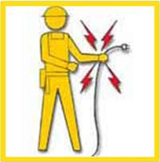
Take Electricity Seriously
Electricity is the second leading cause of death in construction.
Electrocutions make up 12% of construction fatalities annually.
Over 30,000 non-fatal shocks occur each year.
Over 600 deaths occur annually due to electrocution.
Notes:
Trainer's Notes:
Stress the importance of electrical safety.
Remind them not to underestimate the hazards associated with electricity. We sometimes become complacent about electrical hazards because we cannot hear, smell, or see electricity.
Ask participants if they have ever experienced an electrical shock.

Slide 4
Electrical Accidents
Leading Causes of Electrical Accidents:
  Drilling and cutting through cables
  Using defective tools, cables and equipment
  Failure to maintain clearance distance of 10 feet
  Failure to de-energize circuits and follow Lockout/Tagout procedures
  Failure to guard live parts from accidental worker contact
  Unqualified employees working with electricity
  Improper installation/use of temporary electrical systems and equipment
  By-passing electrical protective devices
  Not using GFCI (ground fault circuit interrupters) devices
  Missing ground prongs on extension cords
Notes:
Trainer's Notes:
Leading causes are usually viewed as “symptoms” to a deeper problem.
Often management and leadership problems (root causes) allow the leading causes to exist or form.
Ask the participants to name some root causes which might allow some of these leading causes to exist.

Slide 5
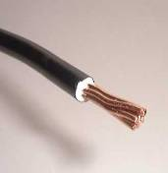
Fundamentals of Electricity
7
Electrical current is the flow of electrons through a conductor.
A conductor is a material that allows electrons to flow through it.
An insulator resists the flow of electrons.
Resistance opposes electron flow.
Notes:
Trainer's Notes:
Remind them that metals conduct electricity.
Explain that some metals, such as copper, are excellent conductors and are used as wire.
Explain that the human body will conduct electricity.
Explain that things like rubber, plastic, glass and ceramic are insulators. Further explain the sentence ‘Explain that things like
rubber, plastic, glass and ceramic are insulators.’ These materials are especially made to be insulators. For
example, rubber tires for vehicles are not insulators because of the steel belts and carbon black added to
color the tire black.

Slide 6
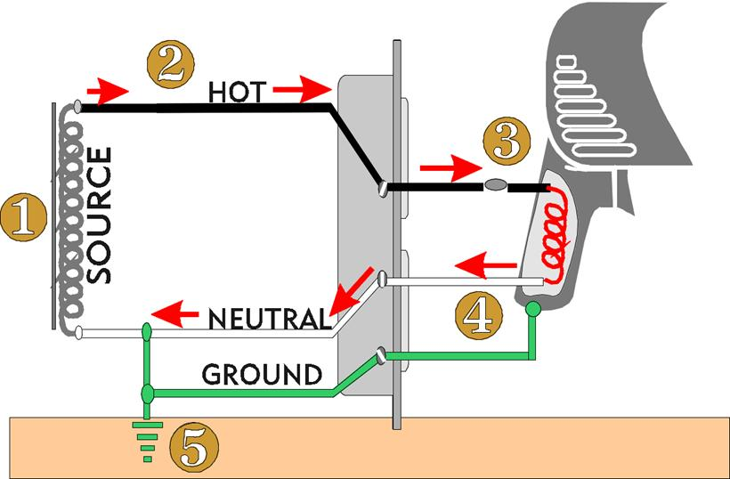
Current Flows in a
Loop or Circuit
SUBPART
K
8
Circuits are AC (alternating current) or DC (direct current).
Current is usually AC.
AC current has five parts:
  (1) Electrical source
  (2) HOT wire to the tool.
  (3) The tool itself
  (4) NEUTRAL wire returns electricity from the tool
  (5) GROUND
Notes:
Trainer's Notes:
Explain that when a circuit works right, current flows through the HOT wire to the tool. It returns to the source through the NEUTRAL wire.
Explain that when something goes wrong with a circuit, it is called an electrical fault.
Explain that when things are right the GROUND has no current flow. A low resistance ground can
help protect the workers from an electrical injury. If there is a short in a piece of electrical equipment, the
current will take the path of least resistance. If the worker has a higher resistance than the ground, then the
current will flow through the ground.

Slide 7
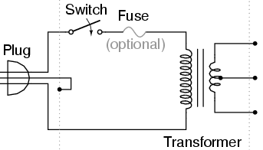
How Shocks Occur
SUBPART
K
9
Current travels in closed circuits through conductors (water, metal, the human body).
Shock occurs when the body becomes a part of the circuit.
Current enters at one point & leaves at another.
Notes:
Trainer's Notes:
Explain that the worst part of the body for current to pass through is the chest cavity. Question: WHY?
ANS. Current directly through the heart is most likely to cause heart fibrillation, that is, interruption of the tiny electrical current that determines the heart’s correct rhythm.
Technically, the heart’s electrical current is 2-3 micro-amps, or .000002-.000003 amps. Compare that to 20.0 amps in a regular 120 volt circuit – 1.0 amp = 1,000 milliamp = 1,000,000 micro-amp.

Slide 8
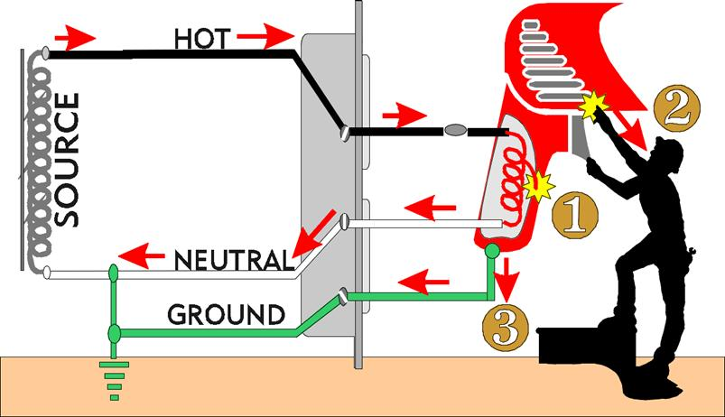
Shocks Occur in
Three Ways
SUBPART
K
10
Contact with both conductors
Contact with one conductor and ground
With a tool: contact with “hot” metal part and ground (1), (2) & (3)
Notes:
Trainer's Notes:
Use the12/2 wire with some of the outside sheathing removed for a visual aid.
Demonstrate the possible scenarios.

Slide 9
Effects of Current Flow
SUBPART
K
13
More than 3 milliamp (ma): painful shock
More than 10 ma: muscle contraction
More than 20 ma: considered severe shock
More than 30 ma: lung paralysis - usually temporary
More than 50 ma: possible ventricular fibrillation (usually fatal)
100 ma to 4 amp: certain ventricular fibrillation (fatal)
Over 4 amp: heart paralysis; severe burns
Notes:
Trainer's Notes:
Explain that when it comes to electricity and the human body’s inability to deal with it, we can no longer talk in terms of Amps and must use smaller units.
Explain that 1 Amp is equal to 1000 milliamps.
Explain that 1/20 of an amp (50 ma) going through the chest cavity can stop the heart and be fatal.
Ask them when the typical circuit breaker will trip ?

Slide 10
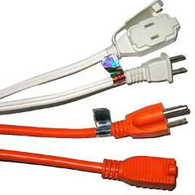
Insulating the Conductors
SUBPART
K
18
The first way to safeguard workers from electrically energized wires is through insulation.
Rubber and plastic is put on wires to prevent shock, fires, short circuits and for strain relief.
It is always necessary to check the insulation on equipment and cords before plugging them in.
Remember, even the smallest defect will allow leakage!
Notes:
Trainer's Notes:
Explain that an insulator is any material with a high resistance to electric current.
Stress the importance of ensuring that the tools and equipment they use is free from insulation related defects.
Ask participants: How does insulation get damaged?

Slide 11
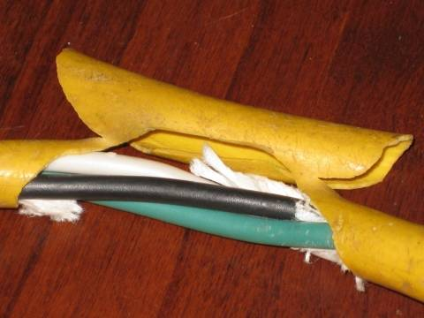
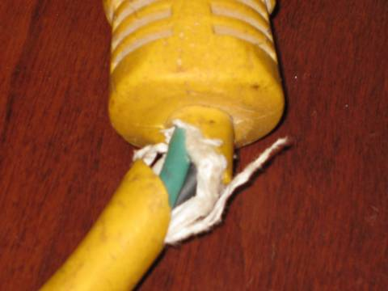
SUBPART
K
20
19
Defective Extension Cords
Photos depict hazardous condition
Notes:
Trainer's Notes:
1926.405(g)(2)(iii) Splices (repaired)
1926.404(f)(6) Path to ground shall be continuous
1926.416(e)(1) and (2) Frayed and damaged extension
cords
1926.405(g)(2)(iv) Strain relief (explain the hazard)
Damaged and cut cord with exposed conductor.
Remind them of just how serious this situation is.
Ask them: What should they do if they see a cord like this on their site?

Slide 12
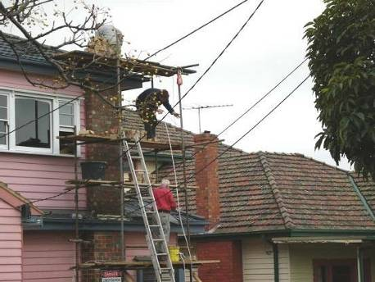
Working Near Overhead Lines
SUBPART
K
22
Clearance of worker and any equipment, tools, materials, or scaffold near uninsulated lines is 10 feet!
Photo depicts hazardous condition
Notes:
Trainer's Notes:
Explain that power line contacts account for a large percent of electrocutions.
Stress the importance of the 10 foot rule.
Remind them that it also applies to the material they handle and the equipment they use.
Stress the fact that the power company is very willing to de-energize lines and work with the contractor.
Clearance also applies to secondary lines going to the house because the lines are usually old, cracked, or maybe even damaged which could
expose energized parts.

Slide 13
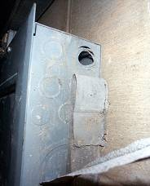
Guarding the Conductors
SUBPART
K
24
The way to safeguard workers from electrically energized wires is by guarding them.
Covers, boxes, and enclosures are often put around conductors to prevent worker contact.
It is always necessary to check that electrical boxes and panels are covered and free from missing “knock-outs”.
Remember, electric equipment operating at 50 volts or more must be guarded!
Photo depicts hazardous condition
Notes:
Trainer's Notes:
Explain that as little 50 volts has the ability to produce enough current flow across the chest to stop the heart within 6 seconds.
Remind them that most of the time they are dealing with at least twice that amount.
When masons need electric power, they need to use a qualified person.
The photo is a violation.
Abatement: Cover the hole with an approved cover.

Slide 14
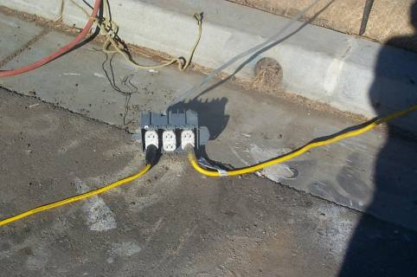
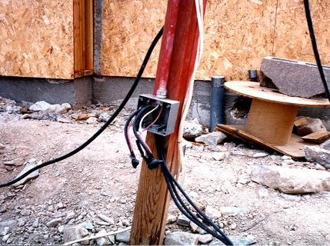
SUBPART
K
25
Guarding the Conductors
Notes:
Trainer's Notes:
1st hazard - No cover around receptacles leaves exposed energized 120 volt parts.
Abatement: Since box is outside, this would need a rain tight cover.
2nd hazard: This box needs to be secured and the non-metallic shield cable (romex) needs to be protected from damage.
Abatement: Mount box on wall, support romex, and protect from damage.

Slide 15
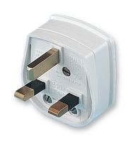

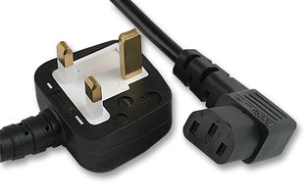
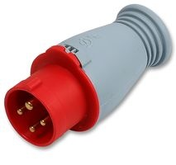
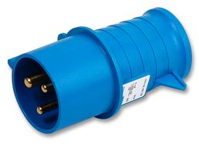
Electrical main cables
  Main cable
  Brown Live - power
  Blue Neutral
  Green/yellow Earth

Slide 16
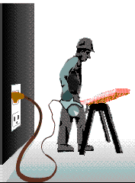
Equipment Grounding
SUBPART
K
27
We can be safe by providing a separate, low resistance pathway for electricity when it does not follow normal flow (ground prong).
Grounding gives the stray current somewhere to go and keeps you from becoming part of the circuit.
Notes:
Trainer's Notes:
Explain that equipment grounding helps to safeguard the equipment operator in the event that a malfunction causes the metal frame of the tool to become energized.
Ground prong on the extension cord is very important. It provides a low resistance path to ground (or source).

Slide 17
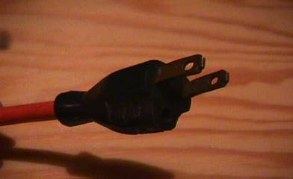
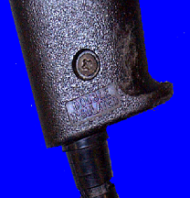
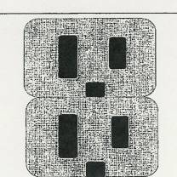
SUBPART
K
31
Do Not Reverse Polarity
The prongs are different
sized so you can’t turn
the plug around. If you
do, the electrical fields
within the motor are always
energized. If there is
moisture present, the case
is likely to be “hot”. Even
with double-insulated tools,
you still could get a shock.
Notes:
Trainer's Notes:
Remind them of the potentially serious consequences of eliminating the ground path. On a three-pronged plug often the other two prongs are the same size and with the ground pin removed, you can reverse the plug, thus reversing the polarity.
Some double insulated tools use a ground prong to ensure that reverse polarity will not occur.

Slide 18
Circuit Protective Devices
SUBPART
K
33
Circuit Breakers and Fuses
  Only protect the building, equipment, and tools from heat build-up!
  Never depend on circuit breakers or fuses to prevent shocks!
Ground Fault Circuit Interrupter (GFCI)
  Is the only device which will protect the worker from shock and electrocution!
Notes:
Trainer's Notes:
Explain the misconception that a fuse or circuit breaker will save their life in the event of accidental contact with electricity.
Stress that fuses and circuit breakers protect equipment, not people, and don’t protect against shocks and electrocutions!
GFCI are very important to protecting people. This can not be stated enough times. Make sure the trainer distinguishes between circuit
breakers, fuses, and GFCI.

Slide 19
GFCI Protection
SUBPART
K
34
All temporary circuits are required to have GFCI protection or:
  Equipment & cords must be included in an Assured Equipment Grounding Conductor Program
An extension cord is a temporary circuit.
Types of GFCIs: receptacle, circuit breaker and portable
Must be wired correctly and tested.
Notes:
Trainer's Notes:
Explain that unless you plug the machine, tool, or light directly into the building’s permanent wiring, it must be run through a GFCI, or must be included in an Assured Equipment Grounding Conductor Program..
Remind them that any and all extension cords must be GFCI- protected or color-coded for the Quarter in which they have been inspected by the Competent Person in charge of the Assured Equipment Grounding Conductor Program.
Show an example of GFCIs.
Assured Equipment Grounding Conductor Program is a very complicated program that takes a competent person to set up the program and
provide the training. All workers need to be trained in this program.

Slide 20
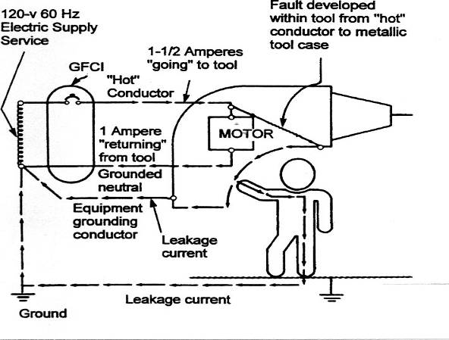
How a GFCI Works
SUBPART
K
35
The GFCI detects
‘leakage’ of 4-6
milliamps & opens
the circuit in 1/40th
of a second.
It will work without
the ground plug
but not fast
enough if you are
the ground .
Notes:
Trainer's Notes:
Explain that a GFCI is a fast-acting circuit breaker which senses small imbalances in the circuit caused by current leakage to ground and, in a fraction of a second, shuts off the electricity.
Explain that the GFCI monitors the current “going” to the tool and compares it to the current “returning”.
Explain that whenever it senses approximately a 5ma difference it shuts down the circuit in 1/40 of a second.
A GFCI does work if there is no ground, since it is working based on the difference in current between the two conductors. However, there is no protection against a dead short with no path to ground.
Further explain about strain relief. Further explain that if the neutral is pulled away, then there is not GFCI protection.

Slide 21
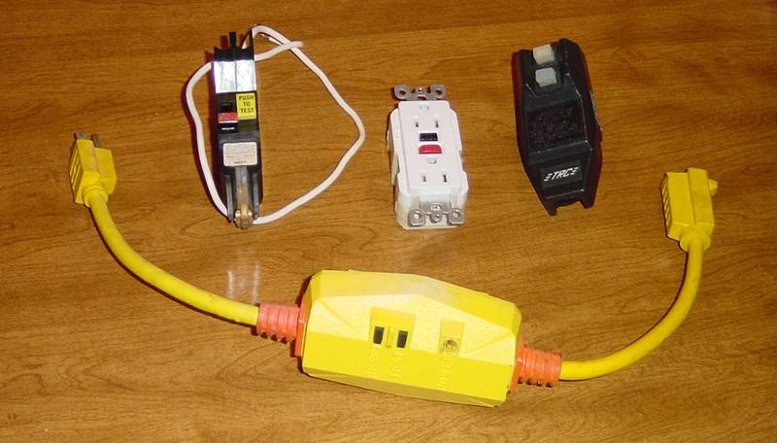
Types of GFCI Protection
SUBPART
K
36
Notes:
Trainer's Notes:
Discuss and demonstrate various types of GFCI equipment.
Explain how they can be wired incorrectly and have the indicator lights work but actually fail to protect.
Explain GFCI-protected receptacles in series.
Explain how often GFCI should be tested and how.

Slide 22
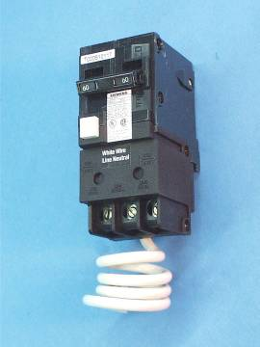
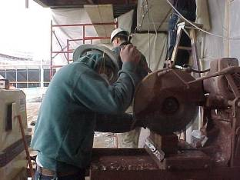

Types of GFCI Protection
SUBPART
K
37
A GFCI breaker must be installed to protect workers using 220V masonry saws.
Notes:
Trainer's Notes:
This would be a citable offense by OSHA.

Slide 23
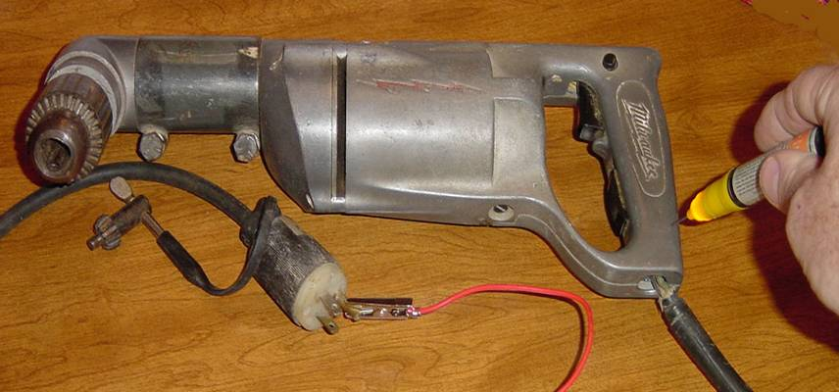
Checking for Ground Continuity
SUBPART
K
40
What else we should we notice here?
Photo depicts hazardous condition
Notes:
Trainer's Notes:
Discuss strain relief and checking the windings and bushings to the motor.
The tester used in this photo is a continuity tester.

Slide 24
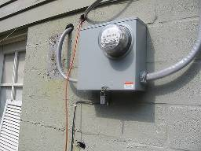
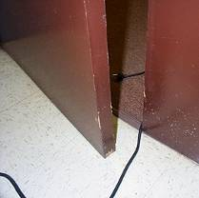
Extension Cords and Cables
SUBPART
K
43
Must be in good shape without splices.
Cannot be secured with staples, nails or bare wire.
Must be protected from damage.
Must have a ground pin.
Should be inspected regularly and pulled from service if defective.
Cannot be repaired with electrical or duct tape. Must repair with heat-shrink sleeve or bonding/vulcanizing tape to retain original insulation properties.
Photos depict hazardous condition
Notes:
Trainer's Notes:
Remind the participants how often cords are used on the site.
Ask them how cords can get damaged and how to protect cords from damage.
Explain the rating of cords and read a cord rating to them.
Demonstrate how to inspect a cord.
Extension cords can only be repaired by a qualified person.
Extension cords shall be heavy or extra heavy duty insulation which is stamped on the outer jacket. (see code on cord).
Extension cords can only be repaired if after being repaired the cord is equal or better than the original condition of the cord.

Slide 25
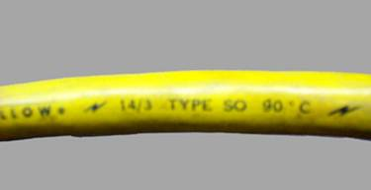
Acceptable Cord Types
SUBPART
K
44
All cords must meet the National Electric Code’s (NEC) requirement for Hard/Extra Hard type.
Look for markings stamped on cords.
Acceptable Cord Types
  Extra Hard Use Markings: S, ST, SO, STO
  Hard Usage Markings: SJ, SJO, SJT, SJTO
Notes:
Trainer's Notes:
Pass around various pieces of acceptable cord types.
Ask participants to locate markings.
After participants have located markings, pass around a section of 2-wire household cord.

Slide 26
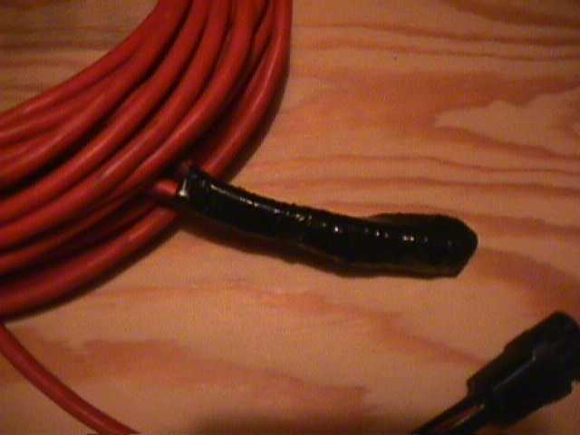
SUBPART
K
45
Notes:
Trainer's Notes:
This cord should be pulled from service.
Remind them that splices are not permitted.
This is a violation of the OSHA Standards.

Slide 27
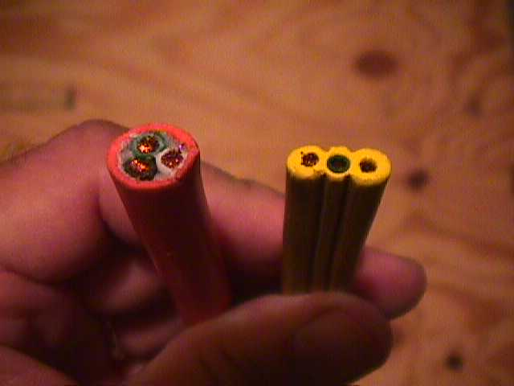
SUBPART
K
46
Extension Cords-What’s the Difference?
No flat cords allowed on construction sites!
Notes:
Trainer's Notes:
The extension cord on the left is a ‘hard, or extra-hard usage’ type.
The one on the right is not. Discuss the potential for exposure of the conductors.
Ask them why they think these flat molded cords are not permitted on site?
Explain to them that the yellow molded cord has the conductors molded into the outside covering only and does not have double the insulation.
The cord on the right is a violation of the OSHA Standards.

Slide 28
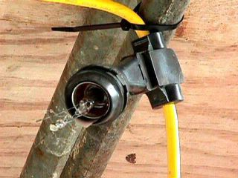
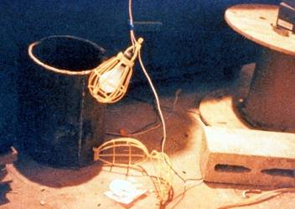
Temporary Lighting
SUBPART
K
48
All bulbs must be guarded
No broken bulbs or empty sockets
Not suspended by wiring
Low voltage for wet locations
Photos depict hazardous condition
Notes:
Trainer's Notes:
Explain that even though most of the time temporary lighting is well out of the worker’s reach, often a piece of conduit, re-bar, and other materials are capable of making contact. Explain the importance of keeping systems in good shape.
The photos show OSHA violations.

Slide 29
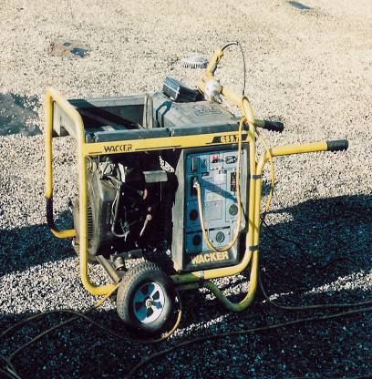
Portable Generators
SUBPART
K
49
The frame of the portable generator need not be grounded if:
  the generator supplies only cord and plug connected equipment.
  The non-current carrying metal parts of equipment and the equipment grounding conductor terminals of the receptacles are bonded to the generator frame.
  GFCI is required if >5kV or if generator provides 220V as well as 110V.
Notes:
Trainer's Notes:
It may be helpful to have an owner’s manual for a given generator to help explain generator safety.

Slide 30
Safe Work Practices
SUBPART
K
50
Before work begins, the employer must determine where exposed and concealed electrical circuits are located.
Once found, warning signs/labels must be posted.
Workers need to know the location, hazards, and protective measures.
Notes:
Trainer's Notes:
Explain that having the physical environment in good shape (i.e., tools, circuits, equipment etc..) is only half of the safety equation. Safe work practices is the other half.
Need competent person.

Slide 31

Safe Work Practices
SUBPART
K
51
Competent Person determines if performance of work could bring contact with energy.
  Distance of the worker to the energy source should be considered first.
  Tools, materials, and processes should also be considered to see if they could potentially shorten the safe separation distance.
    Examples: Metal Ladders, Re-bar, Forklift, Scaffold Frames, etc.
Notes:
Trainer's Notes:
Stress the importance of thinking through each operation to determine whether a tool, material or process will effect their proximity to an energy source.
Workers and equipment must be 10 feet from overhead lines. Competent person has the knowledge and the authority to correct hazards.

Slide 32
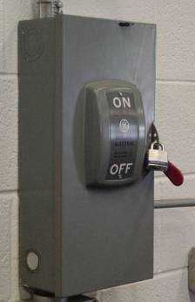
Safe Work Practices
SUBPART
K
52
Must not permit work near electric circuits unless the worker is protected by:
  De-energizing the circuit and grounding it.
  Guarding it effectively by insulation.
  Other means (maintaining safe separation)
De-energized circuits and equipment must be locked/tagged out.
Notes:
Trainer's Notes:
Remind them that they should not be exposed to energized unguarded electrical circuits.
Workers shall stay away, 4 feet or more, from exposed energized devices which are 600 volts or less. If panels and disconnects are
open, see a qualified person to correct the hazard.

Slide 33
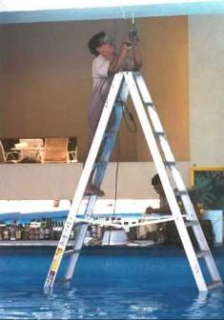
Safe Work Practices
SUBPART
K
53
No metal ladders for or near electrical work.
No wet hands when plugging or unplugging cords/equipment.
No raising or lowering tools by the cord.
Unless equipment is designed for it, cannot be used in damp and wet locations.
Photo depicts hazardous condition
Notes:
Trainer's Notes:
Ask student if they can think of any additional safe work practices?
Ask them what type of ladders should be used around electricity?
Is there a competent person on this jobsite?

Slide 34
Electrical Safety
SUBPART
K
54
Common OSHA Citations:
  .404(b)(1)(i): Branch circuits: GFCI protection/Assured Equipment Grounding Conductor Program
  .404(f)(6): Grounding path
  .403(b)(2): Equipment installation and use
  .404(b)(1)(ii): GFCI
  .403(i)(2)(i): Guarding live parts
How can the hazards addressed by these Standards best be corrected, controlled, or eliminated?
Notes:
Trainer's Notes:
Review the Top Five Serious Citations
Ask the participants how each of the five hazards could be abated.
1926. 416(a)(1), and/or (2), and/or (3)
1926.416 (e)(1) and/or (2)
1926.20(b)(1)
1926.21(b)(2)

Slide 35
Summary – Hazards & Protections
SUBPAR
55
Hazards
Inadequate wiring
Exposed electrical parts
Wires with bad insulation
Ungrounded electrical systems and tools
Overloaded circuits
Damaged power tools and equipment
Using the wrong PPE and tools
Overhead power lines
All hazards are made worse in wet conditions
Damaged extension cords
Unqualified workers doing electrical work
Protective Measures
Proper grounding
Use GFCI’s
Use fuses and circuit breakers
Guard live parts
Lockout/Tagout
Proper use of flexible cords
Close electrical panels by Competent Person
Employee training
Ensure Competent Person on site
Use proper approved electrical equipment
Qualified person install electrical devices
Notes:
Trainer's Notes:
Stress the importance of thinking through each operation to determine whether a tool, material or process will effect their proximity to an energy source.

Slide 36
Thank you

